Slide 1
The Template Method Pattern (Behavioral)

Slide 2
Motivation
In software development we frequently encounter a general algorithm that gets repeated with several variations for different contexts.
The variations are often implemented using
multiway branches/conditional statements
copy-and-paste
Problems
difficult to understand
difficult to maintain
What if the algorithm needs to be modified?
What if we need to add a new variation?

Slide 3
Motivation (continued)
The Template Method pattern can be used to eliminate duplication and improve source code understanding and maintainability.
Identify the basic algorithm template and the different variations.
Implement the algorithm in a method that calls abstract methods to accommodate the variations.
For each variation, create a subclass that implements the abstract methods.
The Template Method is a fundamental technique for code reuse.

Slide 4
Template Method Pattern
Intent: Define the skeleton of an algorithm in an operation, deferring some steps to subclasses.
Template Method lets subclasses redefine certain steps of an algorithm without changing the algorithm’s nature.
Also Known As: The Hollywood Principle (“Don’t call us; we’ll call you.”)

Slide 5
Template Method Pattern (continued)
Applicability: The Template Method pattern should be used
when designing an algorithm that is potentially reusable in multiple programs. Implement the control flow and invariant parts of an algorithm in a Template Method, and leave it up to subclasses to implement the behavior that can vary.
when common behavior among subclasses should be factored and localized in a common class to avoid code duplication.
to control subclasses extensions. You can define a template method that calls “hook” operations at specific points, thereby permitting extensions only at those points.

Slide 6
Template Method Pattern (continued)
Structure
AbstractClass
templateMethod()
primitiveOperation1()
primitiveOperation2()
...
primitiveOperation1()
…
primitiveOperation2()
...
Client
ConcreteClass
primitiveOperation1()
primitiveOperation2()

Slide 7
Template Method Pattern (continued)
Participants
AbstractClass
defines abstract primitive operations that concrete subclasses define to implement steps of an algorithm.
implements a template method defining the skeleton of an algorithm The template method calls primitive operations as well as operations defined in AbstractClass or those of other objects.
ConcreteClass
implements the primitive operations to carry out subclass-specific steps of the algorithm.

Slide 8
Template Method Pattern (continued)
Collaborations
ConcreteClass relies on AbstractClass to implement the invariant steps of the algorithm.

Slide 9
Template Method Pattern (continued)
Consequences
Template methods are particularly important in class libraries since they factor out common behavior in library classes.
Template methods can call
concrete operations (in its own class, other classes)
primitive operation (abstract operations)
hook operations (provide default behavior but may be overridden)
It is important for template methods to specify which operations are hooks (may be overridden) and which are primitive (abstract operations that must be overridden).

Slide 10
Template Method Pattern (continued)
Consequences (continued)
A parent class calls operations implemented in a subclass, and not the other way around.

Slide 11
Template Method Pattern (continued)
Implementation
Operations that must be overridden by a subclass should be given protected access and declared as abstract (pure virtual in C++)
In general, the template method should be not be overridden. It should be declared as final in Java (nonvirtual method in C++)
To allow a subclass to insert optional code at a specific point in the algorithm, insert “hook” methods into the template method. These hook methods define default behavior at that point in the code, which may do nothing.

Slide 12
Template Method Pattern (continued)
Implementation (continued)
Try to minimize the number of operations that a subclass should override; otherwise using the template method becomes tedious.
Consider adding a prefix to primitive operations; e.g., “do”

Slide 13
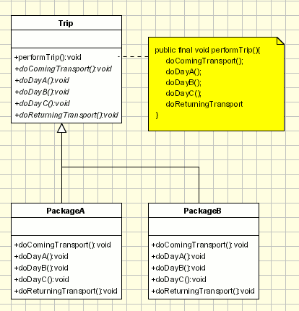
Example:
Template Pattern

Slide 14
Related Patterns
Factory Methods are often called by template methods.
Template methods use inheritance to vary part of an algorithm. Strategies use delegation to vary the entire algorithm.

Slide 15
References
Template method pattern (Wikipedia)
http://en.wikipedia.org/wiki/Template_method_pattern
Template Method Pattern (Object-Oriented Design)
http://www.oodesign.com/template-method-pattern.html
The Template Method Pattern (Bob Tarr)
http://userpages.umbc.edu/~tarr/dp/lectures/Template-2pp.pdf
Template Method Design Pattern (SourceMaking)
http://sourcemaking.com/design_patterns/template_method

